Slide 1
Mortgage Calculator – UX Re-Design
Student Name: Suvankar Das
Course / Module:
Designing and Prototyping the Mortgage Calculator

Slide 2
Problem Background
Users reported difficulty understanding monthly mortgage costs
• Too many steps and unclear interface in original version
• Lack of visual flow and immediate clarity
• Need for improved readability and user guidance
Goal → Create a new user-friendly mortgage calculator interface

Slide 3
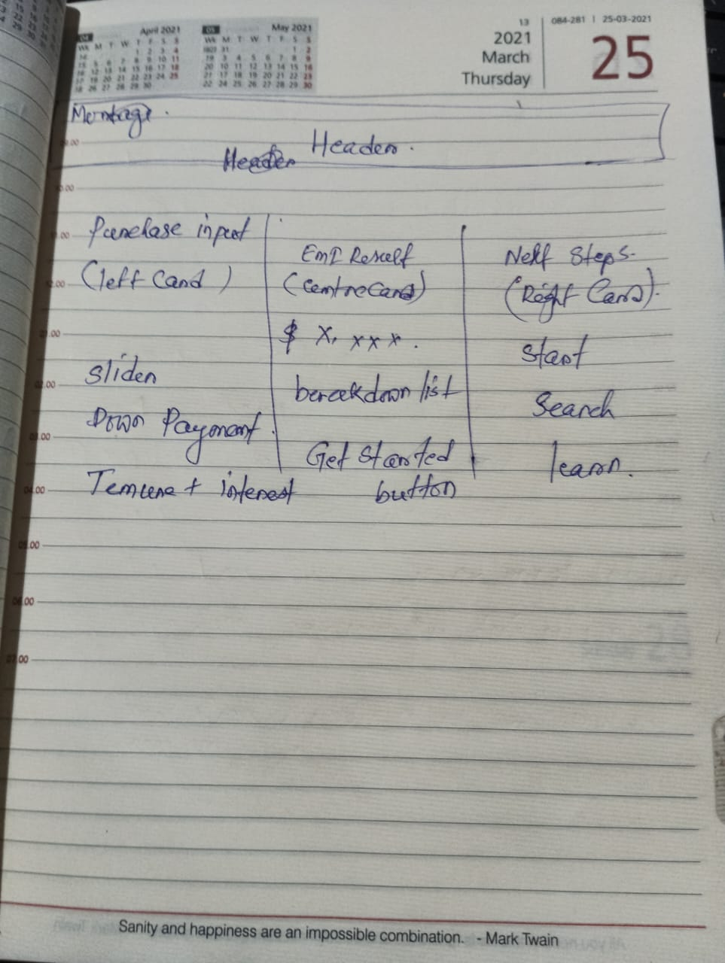
Sketch (Low-Fidelity Prototype)
Designed layout with 3-panel structure:
Left → Inputs
Center → Monthly Payment Result
Right → Next-step Actions
• Intention: Logical flow that mirrors user decision process

Slide 4
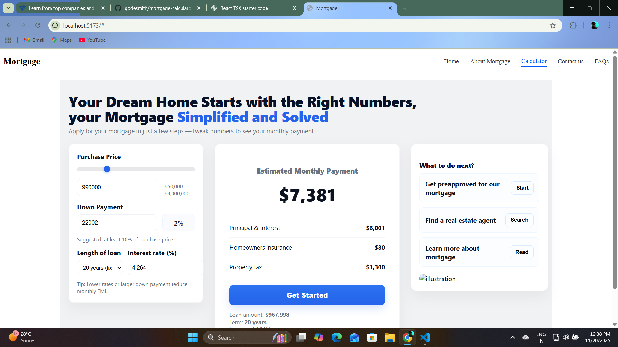
Digital Wireframe (React)
Built in React with reusable components
• Cards for readability and modularity
• Blue color hierarchy supports clarity + attention on key result (EMI)

Slide 5
Feedback From Virtual Focus Group
Positive feedback:
✓ “The loan summary is much easier to understand now”
✓ “The right-side actions make the next steps clear”
✓ “The large EMI number helped instantly”
Suggested improvements:
• Header spacing too large → fixed
• Better alignment on different laptop screens → done

Slide 6
Final Outcome + Conclusion
• Improved interface with strong clarity and flow
• Supports decision-making through visual hierarchy
• Highly responsive for laptop + desktop screens
• Converts user intent into action (Next-step cards)

